Slide 1
Abstract Classes
In Java

Slide 2
class
We know that class is a model for creating objects.
If a object has the properties and actions mentioned in the class, then that object belongs to the class.
The rule is that any thing is written in the class is applicable to all of its objects.
For example Take Myclass that contains a method calculate() that calculates square value of a given number.
In the above program , the requirement for all the objects is same.
But some times the requirement of the objects will be different and entirely depend on the specific object only.

Slide 3
A class properties shared by all the objects
package com.abstractclass.in;
class Myclass
{
void calculate(double x)
{
System.out.println("Square = "+(x*x));
}
}
public class Common {
public static void main(String[] args) {
// TODO Auto-generated method stub
Myclass obj1= new Myclass();
Myclass obj2= new Myclass();
Myclass obj3= new Myclass();
// call calculate
obj1.calculate(3);
obj2.calculate(4);
obj3.calculate(5);
}
}

Slide 4
Since, calculate() has to perform 3 different tasks depending on the object, we cannot write the code to calculate square value in the body.
On the other hand, we cannot write the three different methods like calculate_square(), calculate_sqrt() and calculate_cube() in Myclass, then all the three methods are available to all the three objects which is not advisable.

Slide 5
To serve each object with the one and only required method, we can follow the steps:
First, let us write a calculate() method in Myclass. This means every object wants to calculate something.
If we write body for body, it will be commonly available. So we wont write body for calculate(). Such methods is called abstract method.
Since we write abstract method in Myclass and it is called abstract class.
Now derive a sub class Sub1 from Myclass and write the calculate method with your requirement. Similar way create Sub2 and Sub3.

Slide 6
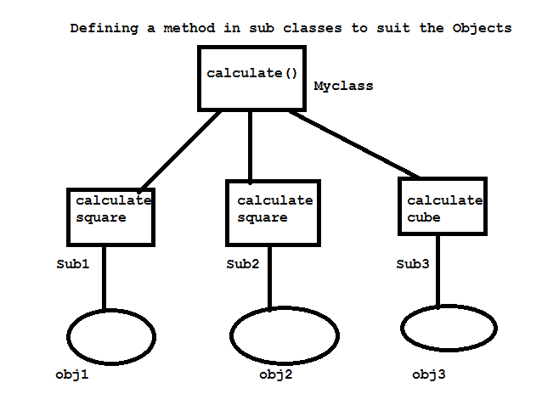

Slide 7
Abstract Method and Abstract class
An abstract method does not contain any body.
It contains only method header. So we can say it is an incomplete method.
An abstract class is a class that generally contains some abstract methods.
Both the abstract method and abstract class declare by using ‘abstract’ keyword.
Since abstract class contains incomplete methods, it is not possible to estimate the total memory required to create the object.
So JVM cannot create objects to an abstract class.
We should create sub classes and all the abstract methods should be implemented(body should be written) in the sub classes.
Then it is possible to create objects to the sub classes since they are complete classes.

Slide 8
What is abstract method?
An abstract method is a method with out method body. An abstract method is written when the same method has to perform different tasks depending on the object calling it.
What is abstract class?
An abstract class is a class that contains 0 or more abstract methods.

Slide 9
Different Objects can access different methods
package com.abstractclass.in;
abstract class Myclass1
{
abstract void calculate(double x);
}
class Sub1 extends Myclass1
{
void calculate(double x)
{
System.out.println("Square ="+(x*x));
}
}
class Sub2 extends Myclass1
{
void calculate(double x)
{
System.out.println("Square root ="+Math.sqrt(x));
}
}
class Sub3 extends Myclass1
{
void calculate(double x)
{
System.out.println("cube ="+(x*x*x));
}
}
public class Different {
public static void main(String[] args) {
// TODO Auto-generated method stub
Sub1 obj1= new Sub1();
Sub2 obj2= new Sub2();
Sub3 obj3= new Sub3();
Myclass1 ref;
ref=obj1;
ref.calculate(3);
ref=obj2;
ref.calculate(4);
ref=obj3;
ref.calculate(5);
//obj1.calculate(3);
//obj2.calculate(4);
//obj3.calculate(5);
}
}

Slide 10
Different Objects can access different methods
package com.abstractclass.in; abstract class Myclass1 { abstract void calculate(double x); } class Sub1 extends Myclass1 { void calculate(double x) { System.out.println("Square ="+(x*x)); } } class Sub2 extends Myclass1 { void calculate(double x) { System.out.println("Square root ="+Math.sqrt(x)); } } | class Sub3 extends Myclass1 {void calculate(double x) {System.out.println("cube ="+(x*x*x)); } } public class Different { public static void main(String[] args) { // TODO Auto-generated method stub Sub1 obj1= new Sub1(); Sub2 obj2= new Sub2(); Sub3 obj3= new Sub3(); Myclass1 ref; ref=obj1; ref.calculate(3); ref=obj2; ref.calculate(4); ref=obj3; ref.calculate(5); //obj1.calculate(3); //obj2.calculate(4); //obj3.calculate(5); } }

Slide 11
package com.abstractclass.in;
abstract class Car{
//registraction number
int regno;
Car(int regno)
{
this.regno=regno;
}
// all cars will have a fuel tank.
void openTank()
{
System.out.println("Fill the tank");
}
abstract void steering(int direction, int angle);
abstract void braking(int force);
}
class Maruti extends Car
{
Maruti(int regno)
{
super(regno);
}
@Override
void steering(int direction, int angle) {
// TODO Auto-generated method stub
System.out.println("Take a turn");
System.out.println("This is ordinary steering");
}
@Override
void braking(int force) {
// TODO Auto-generated method stub
System.out.println("Brakes Applied");
System.out.println("These are hydraulic brakes");
}
void wings()
{
System.out.println("THis is wings in Maruti class");
}
}
class Santro extends Car
{
Santro(int regno)
{
super(regno);
}

Slide 12
abstract class Car{ //registraction number int regno; Car(int regno) {this.regno=regno; }// all cars will have a fuel tank. void openTank() { System.out.println("Fill the tank"); } abstract void steering(int direction, int angle); abstract void braking(int force); } class Maruti extends Car { Maruti(int regno) { super(regno); } @Override void steering(int direction, int angle) { System.out.println("Take a turn"); System.out.println("This is ordinary steering"); } | @Override void braking(int force) { // TODO Auto-generated method stub System.out.println("Brakes Applied"); System.out.println("These are hydraulic brakes"); } void wings() { System.out.println("THis is wings in Maruti class"); } } class Santro extends Car { Santro(int regno) { super(regno); }

Slide 13
Let us take another example
Better way to understand.
We see many cars on the road.
These cars are all objects of car class.
Ex: Martui, Satro etc.
We plan to write Car class, it contains all the properties(variables) and methods(actions).
Following Members in Car class
Registration number : Same to every car. So will keep as instance variable. Common to all the objects, So it can written in the Car class.

Slide 14
Fuel Tank: Every car is having a fuel tank, opening and filling the tank is action.
So we take method like: void openTalk()
Every car have the same mechanism of opening the tank. So concrete method.
A concrete method is a method with body.
Steering: Action
Void Steering(int direction, int angle)
All cars not have same steering mechanism.
So it is not possible to write a particular mechanism in steering method.
Brakes: Action
Void braking(int force)

Slide 15
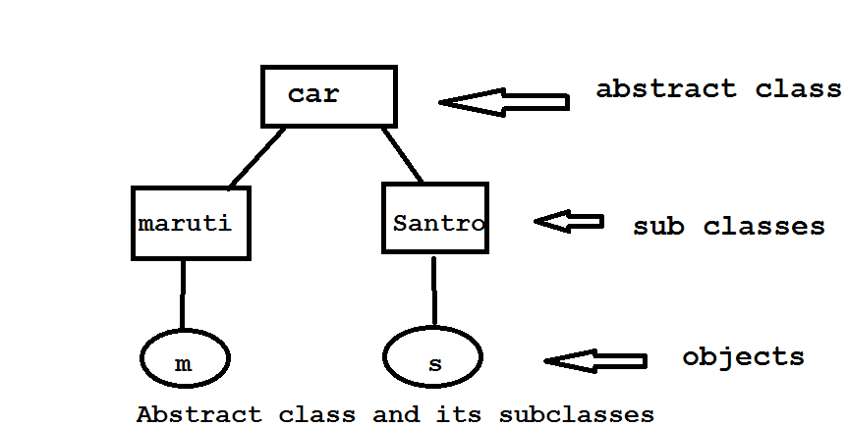
Diagram representation

Slide 16
Car class
abstract class Car{
//registraction number
int regno;
Car(int regno)
{
this.regno=regno;
}
// all cars will have a fuel tank.
void openTank()
{
System.out.println("Fill the tank");
}
abstract void steering(int direction, int angle);
abstract void braking(int force);
}

Slide 17
Maruti class
class Maruti extends Car
{
Maruti(int regno)
{
super(regno);
}
// Maruti uses ordinary Steering
@Override
void steering(int direction, int angle) {
System.out.println("Take a turn");
System.out.println("This is ordinary steering");
}
//// Maruti uses hydraulic brakes
@Override
void braking(int force) {
// TODO Auto-generated method stub
System.out.println("Brakes Applied");
System.out.println("These are hydraulic brakes");
}
}

Slide 18
Santro car.
class Santro extends Car
{
Santro(int regno)
{
super(regno);
}
// Santro uses power steering
@Override
void steering(int direction, int angle) {
// TODO Auto-generated method stub
System.out.println("Take a turn");
System.out.println("This is power steering");
}
// Santro uses gas breaks
@Override
void braking(int force) {
// TODO Auto-generated method stub
System.out.println("Brakes Applied");
System.out.println("These car uses gas brakes");
}

Slide 19
create a program to use all the features of abstract class by creating a reference to it and referring to the sub class objects. Abstract class reference can be used to call the methods of the sub class
public class Usecar {
public static void main(String[] args) {
// TODO Auto-generated method stub
// create sub class objects
Maruti m = new Maruti(1001);
Santro s = new Santro(5005);
//create super class reference
Car ref;
//to use maruti car
ref=m;
ref.openTank();
ref.braking(500);
ref.steering(1, 90);
//ref.wings();
}
}

Slide 20
In the preceding program, we created a reference of the super class and using this reference, we are accessing all the features of the sub classes in a main method.
Why should we create a reference of the super class?
Cant we access the features of the sub class by individually creating sub class objects?
It is perfectly possible to access all the member of the subclass by using sub class object.
But we prefer to use super class reference to access the sub class features because the reference variable can access only those features of the sub class which have been already declared in super class.
if we write an individual method in the sub class, the super class reference cannot access that method.
This is to enforce discipline in the programmers not to add any of their features in the sub classes other than whatever given in super class.

Slide 21
Void wings()
{
System.out.println(“ I am flying”);
}
The above method is not found in super class(car). So super class reference cannot refer to this method. When wings are added to Maruti car, there is a doubt whether it still belong to Car class or not. Wings() method we don’t know it may relate to class Bird or Aeroplane and who knows.
Interview question
How do you force your programmers to implement only the features of your class?
By writing abstract class or Interface.

Slide 22
Summary points on abstract class
AN abstract class is class contains 0 or more abstract methods.
An abstract class can contains instance variables and concrete methods in addition to abstract methods.
Abstract methods and abstract class should be declared by using the keyword ‘abstract’.
All the abstract methods of the abstract class should be implemented in the sub class.
If any abstract method is not implemented, then that sub class should be declared as abstract. In this case, we cannot create an object to the sub class. We should create another sub class to this sub class and implement the remaining abstract method there.
We cannot create an object to abstract class, but we can create a reference of abstract class type.
The reference of abstract class can be used to refer to objects of its sub class.
The reference of abstract class can be used to refer to individual methods of its sub class.
It is possible to derive an abstract class as a sub class from a concrete super class.
We cannot declare a class both abstract and final

